Slide 1
Week 4 Update
5 February 2021
Notes:
Justin feb 5 update: does not have direct force data from pedals, only commercially available power data
“What do you want us to do with forces?”
justin : up to us, he’s happy with less fidelity in the data and pushing forward with the process (fast and loose, quick and far).
“If we had time, we would’ve done x,y,z for validation of the data”
“From his position, we should be qualitatively accurate, not quantitatively accurate”
Easy work flow for translating motion capture marker info into the model and making the model use it as input kinematics
TODO: share github with Justin, send trial vids
Advice from adrian: find a way to automate through MATLAB so we lose a fear of exploring

Slide 2
Agenda
Recap
Next steps
Presentation Update 1
CC

Slide 3
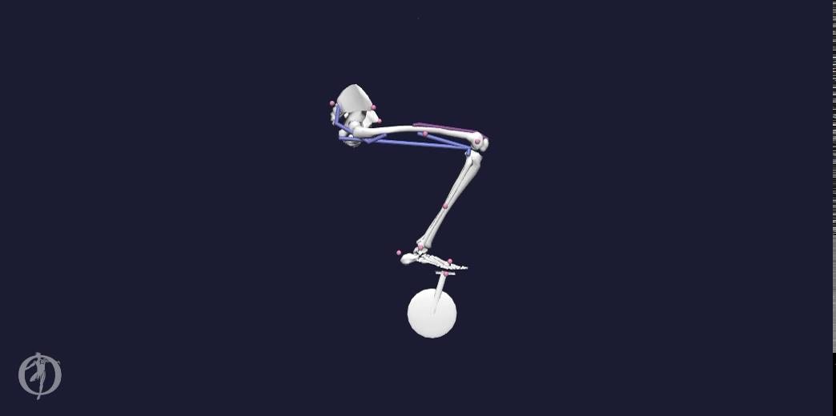
Recap
Many trials
CC

Slide 4
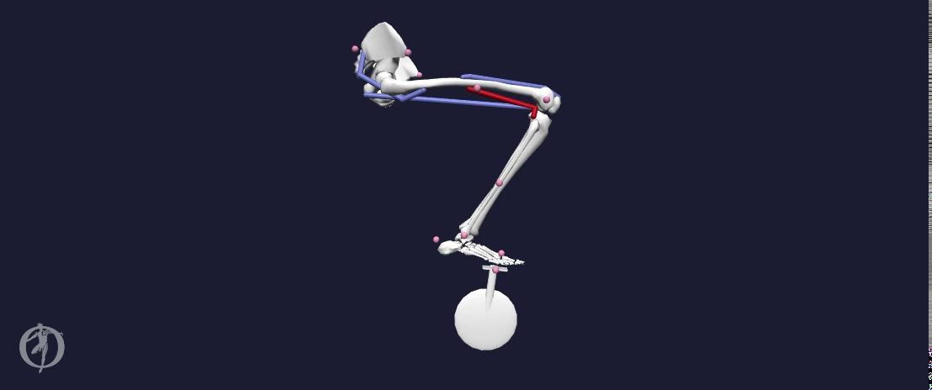
Recap
Success!
CC

Slide 5
Plan: Next 3 Weeks
Parameterizing Model Features
External Forces
Joint Angles
Muscles
OpenSim Model
Notes:
In parallel, we will be parameterizing various model features.
We will parameterize saddle position which will effectively parameterize Joint angles.
We will do this in a bare bones skeletal model
We will aim to add lower limb muscles like gastroc, tibialis anterior, etc. This parameterization of increasing muscle fidelity will allow us to iteratively improve the biomechanical accuracy of our model
Will require muscle end point positioning
We will parameterize external forces by increasing the accuracy of such forces compared to literature. Before we get to actual force parameterization, we will still need to develop 1 last tool to efficiently generate force data.

Slide 6
Plan: Next 3 Weeks
OpenSim Model
Body Kinematics
Muscle States
Metabolics
Compare Result Quantities
Notes:
From our opensim model, because our parameterizations are running in parallel, we will iterate upon various output data.
We will compare these body kinematics, muscle states, and metabolics to other trials of parameterized inputs.

Slide 7
Timeline
Week 2 | Week 3 | Week 4 | Week 5 | Week 6 | Week 7 | Week 8 | Week 9 | Week 10
1/22 | 1/29 | 2/5 | 2/12 | 2/19 | 2/26 | 3/5 | 3/12 | 3/19
Incorporate external forces data |  |  | Define workflow | Parameterize saddle height
Incorporate joint angles data |  |  |  | Parameterize muscles
Tweak OpenSim files |  |  | Create tool for force parameterization |  |  | Collect data on parameterizations
Meet with OpenSim experts & document research and process thoroughly
 | Compute muscle forces & metabolic output through CMC
→ Currently in progress

Slide 8
Questions/Asks
Does the plan sound reasonable?
all
Notes:
Spring gauge on a crank - power crank
Professional versions output 200Hz
Literature is probably a better source than Specialized

Slide 9
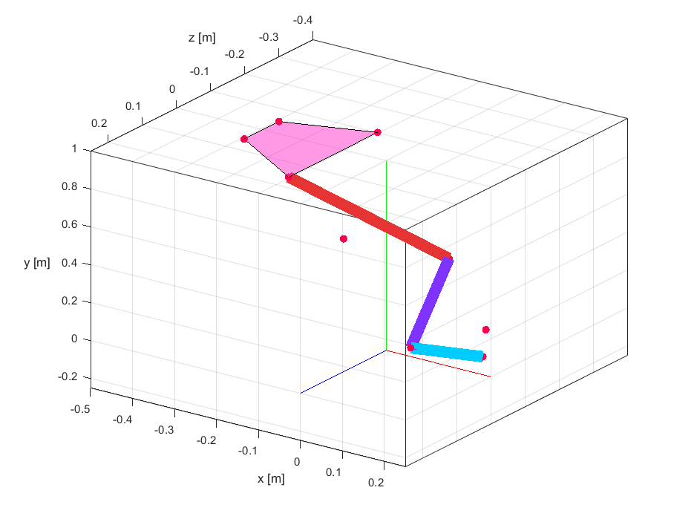
Markers’ Positions
Pelvis
RASI, LASI, RPSI, LPSI
Femur_r
RTHI, RKNE
Tibia_r
RTIB, RANK
Foot
RHEE, RPED, RTOE
DG

Slide 10
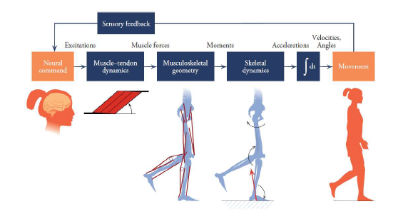
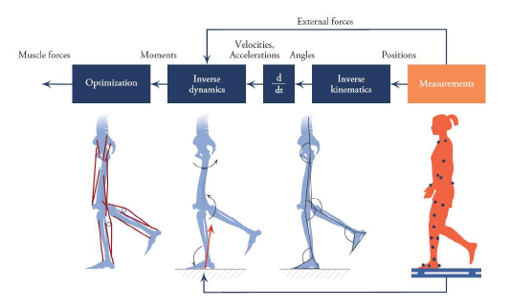
Forward Dynamics (L) vs. Inverse Dynamics (R)
Source: Figure 1.12 and Figure 1.13 Biomechanics of Movement: The Science of Sports, Robotics, and Rehabilitation by Thomas K. Uchida and Scott L. Delp (2020)
DG

Slide 11
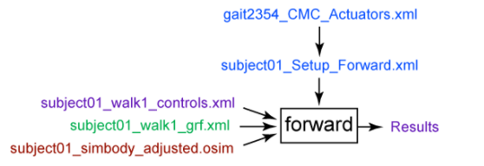
OpenSim Crash Course
Forward Dynamics
The Forward Dynamics Tool is used to calculate joint kinematics based on assumed muscle activations.
Simplest tool
Downside: Muscle activations assumed.
https://simtk-confluence.stanford.edu/display/OpenSim/Getting+Started+with+Forward+Dynamics
Inputs: Muscle excitation w.r.t. time, constraints on bodies’ coordinates (e.g. pelvis xyz-position, foot-on-pedal)
Outputs: Can obtain a wide array of outputs while muscle activation drives the simulation. Most useful will typically be joint angles, muscle-fiber lengths, and other body kinematics.
DG
Notes:
The purpose of inverse kinematics (IK) is to estimate joint angles from experimental data. The purpose of inverse dynamics (ID) is to estimate forces & moments.
CMC is likely our primary tool for obtaining the relevant muscle forces with a well defined trajectory (joint angles) and external loads (pedal reaction forces)

Slide 12
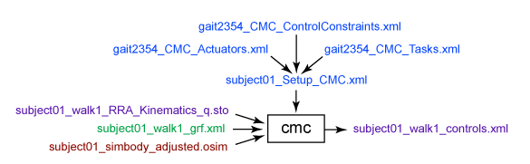
OpenSim Crash Course
CMC Tool (Computed Muscle Control)
The CMC tool is used to calculate muscle excitations based on desired kinematic inputs under various constraints/ boundary conditions.
Difficult to obtain convergence/ optimization
https://simtk-confluence.stanford.edu/display/OpenSim/Getting+Started+with+CMC
Inputs: Kinematics (joint angles, translations), coordinate tracking requests, constraints, actuation, GRFs
Outputs: Muscle activation forces, muscle activations/controls, muscle states of motion (joint angles & velocities; muscle fiber lengths & activations)
Ability to request Metabolic Probes
CMC Tool incorporate principles from Inverse Kinematics (IK) & Inverse Dynamics (ID) workflows
CEC
Notes:
The purpose of inverse kinematics (IK) is to estimate joint angles from experimental data. The purpose of inverse dynamics (ID) is to estimate forces & moments.
CMC is likely our primary tool for obtaining the relevant muscle forces with a well defined trajectory (joint angles) and external loads (pedal reaction forces)

Slide 13
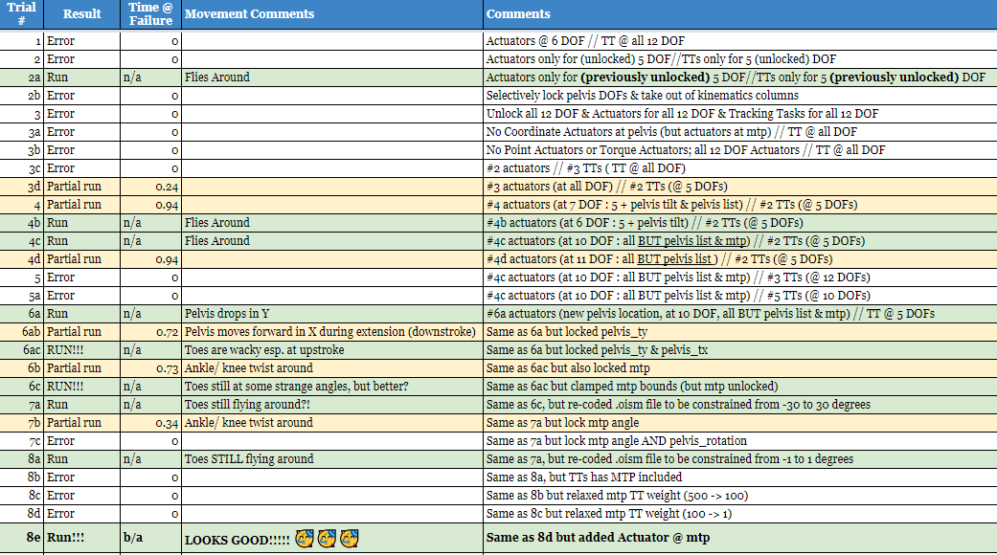
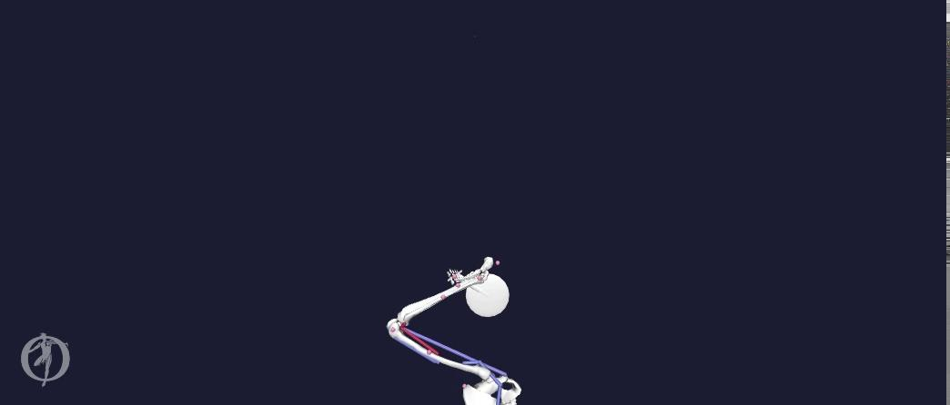
Trial Run Videos
Trial 2a
Trial 4c
Trial Tracker
Model successfully runs with CMC Tool with successful optimization to match kinematics but body motion is not correct.
CEC

Slide 14
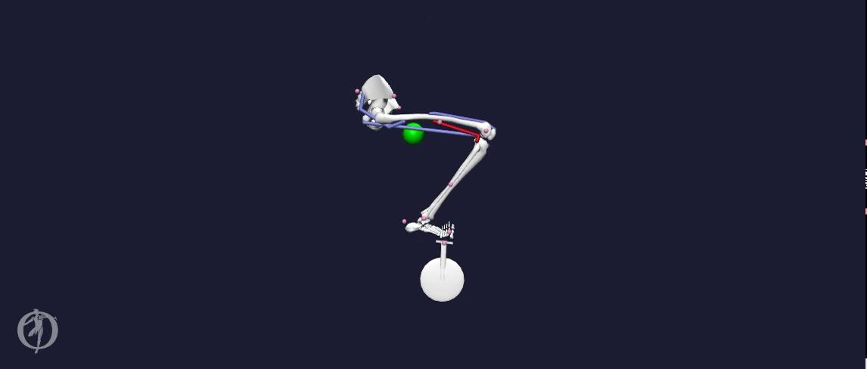
Trial Run Videos (cont.)
Motion nears desired kinematics & dynamics with CMC tool. MTP (metatarsophalangeal) joint does not follow desired motion.
Trial 6c
CEC

Slide 15
Trial Run Videos (cont.)
Success! Motion appears as desired with CMC tool.
Trial 8e
CEC

Slide 16
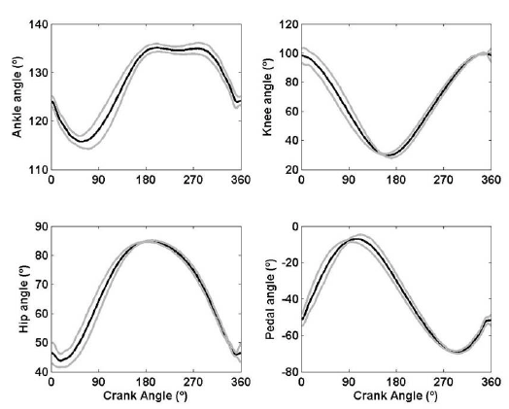
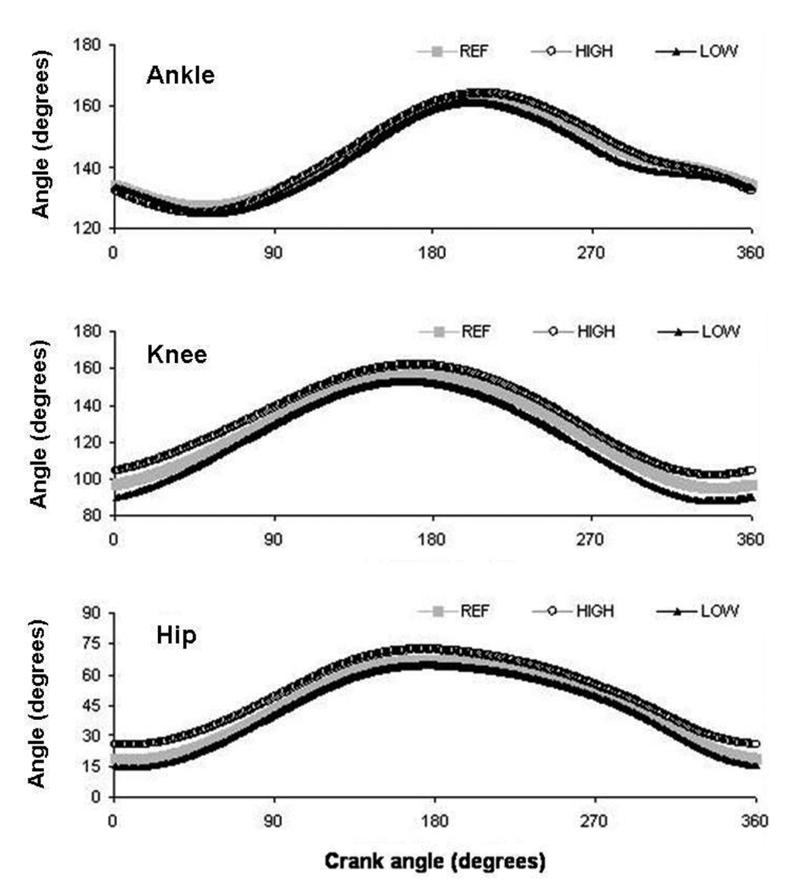
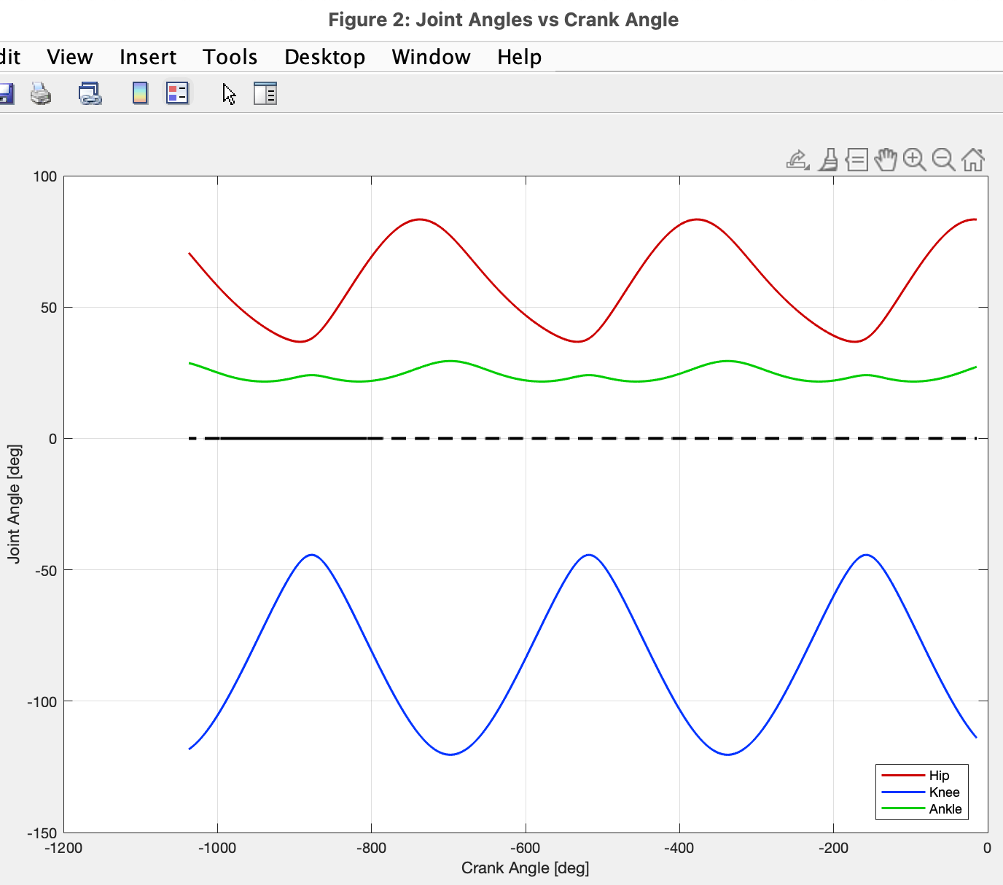
Model Joint Angles
Bini (2010)
Bini (2014)
ME 485 Forward Dynamics
CC
Notes:
*Need to double check reference points / conventions on how joint angles are measured in OpenSim vs how they are measured in referenced literature

Slide 17
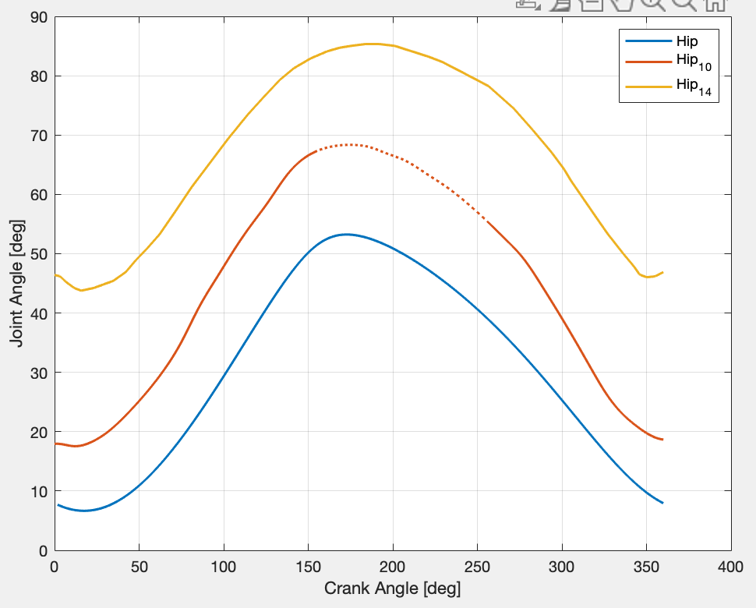
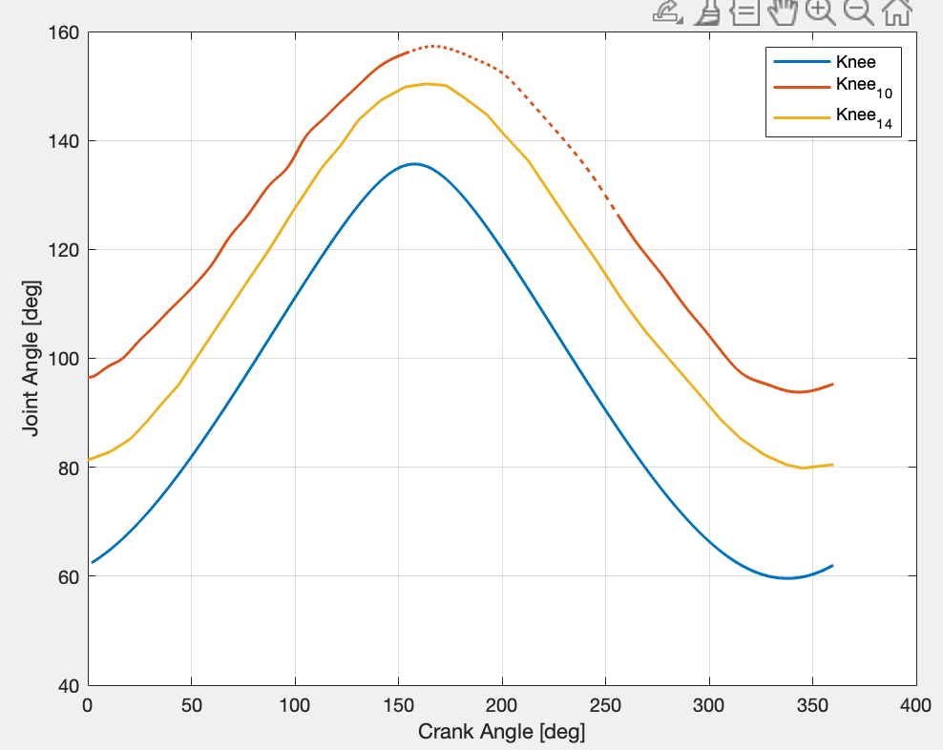
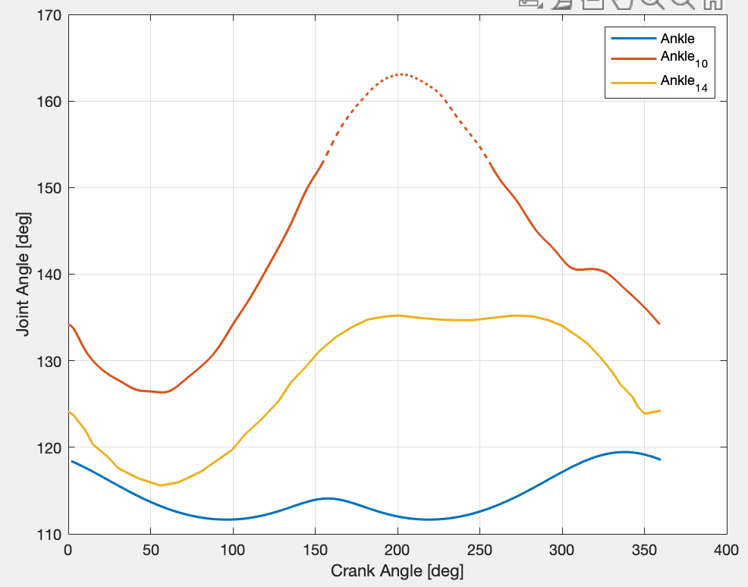
Model Joint Angles cont.
Hip Comparisons
Knee Comparisons
Ankle Comparisons
CC
Notes:
*Need to double check reference points / conventions on how joint angles are measured in OpenSim vs how they are measured in referenced literature

Slide 18
Model Joint Angles cont.
Hip Comparisons
Knee Comparisons
Ankle Comparisons
Bini 2010 Hip Angles
Bini 2014 Knee Angles
Bini 2014 Ankle Angles
CC
Notes:
*Need to double check reference points / conventions on how joint angles are measured in OpenSim vs how they are measured in referenced literature

Slide 19
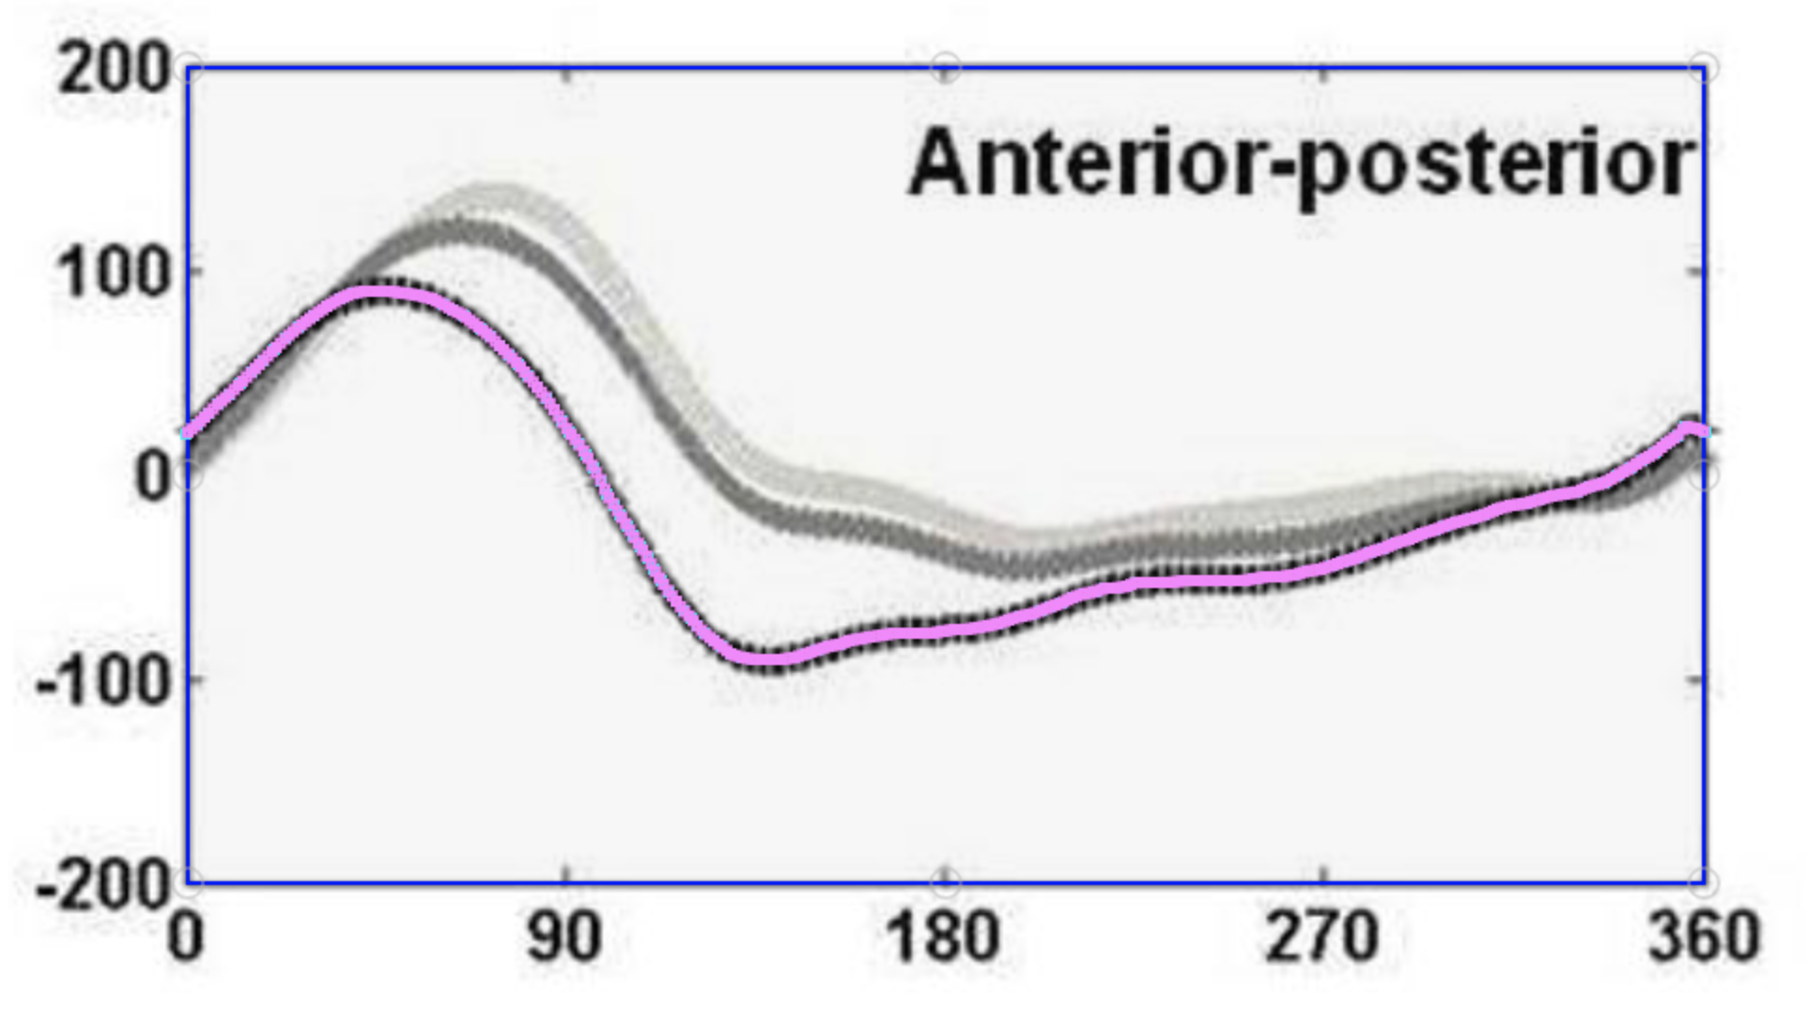
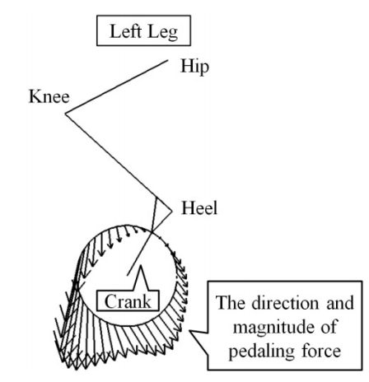
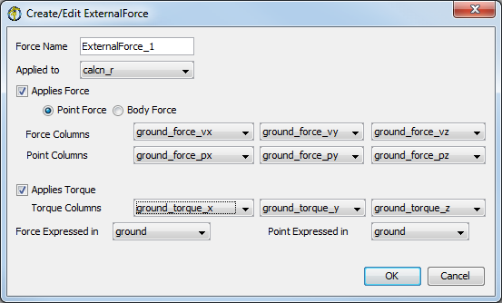
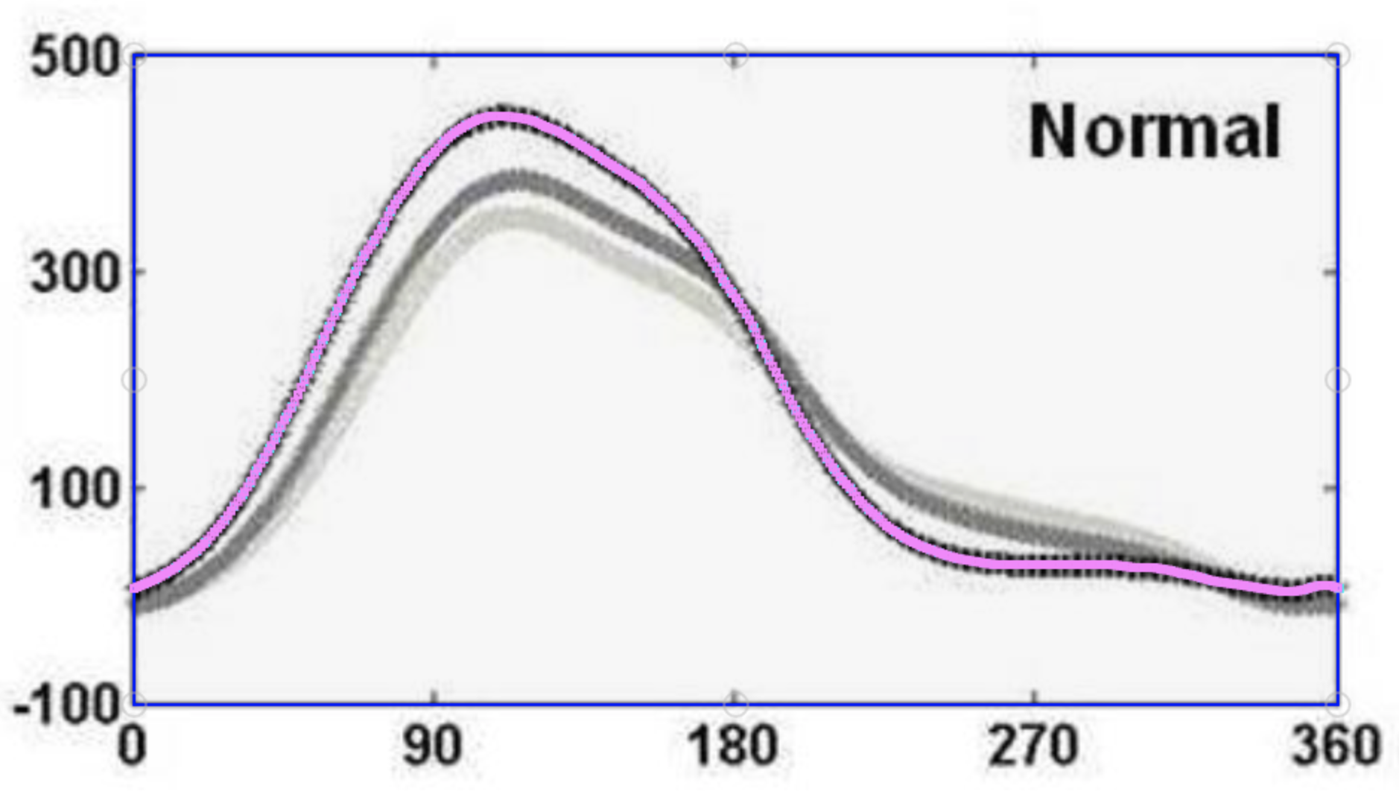
External Forces on Model
OpenSim External Forces Tutorial
Yamashita (2013)
SR
Bini (2013)
Notes:
Foot and pedal interactions assuming clip will change the normal force on the foot….how should we incorporate this?

Slide 20
Recall
Joint angles
GRFs
SR
Notes:
*Need to double check reference points / conventions on how joint angles are measured in OpenSim vs how they are measured in referenced literature

Slide 21
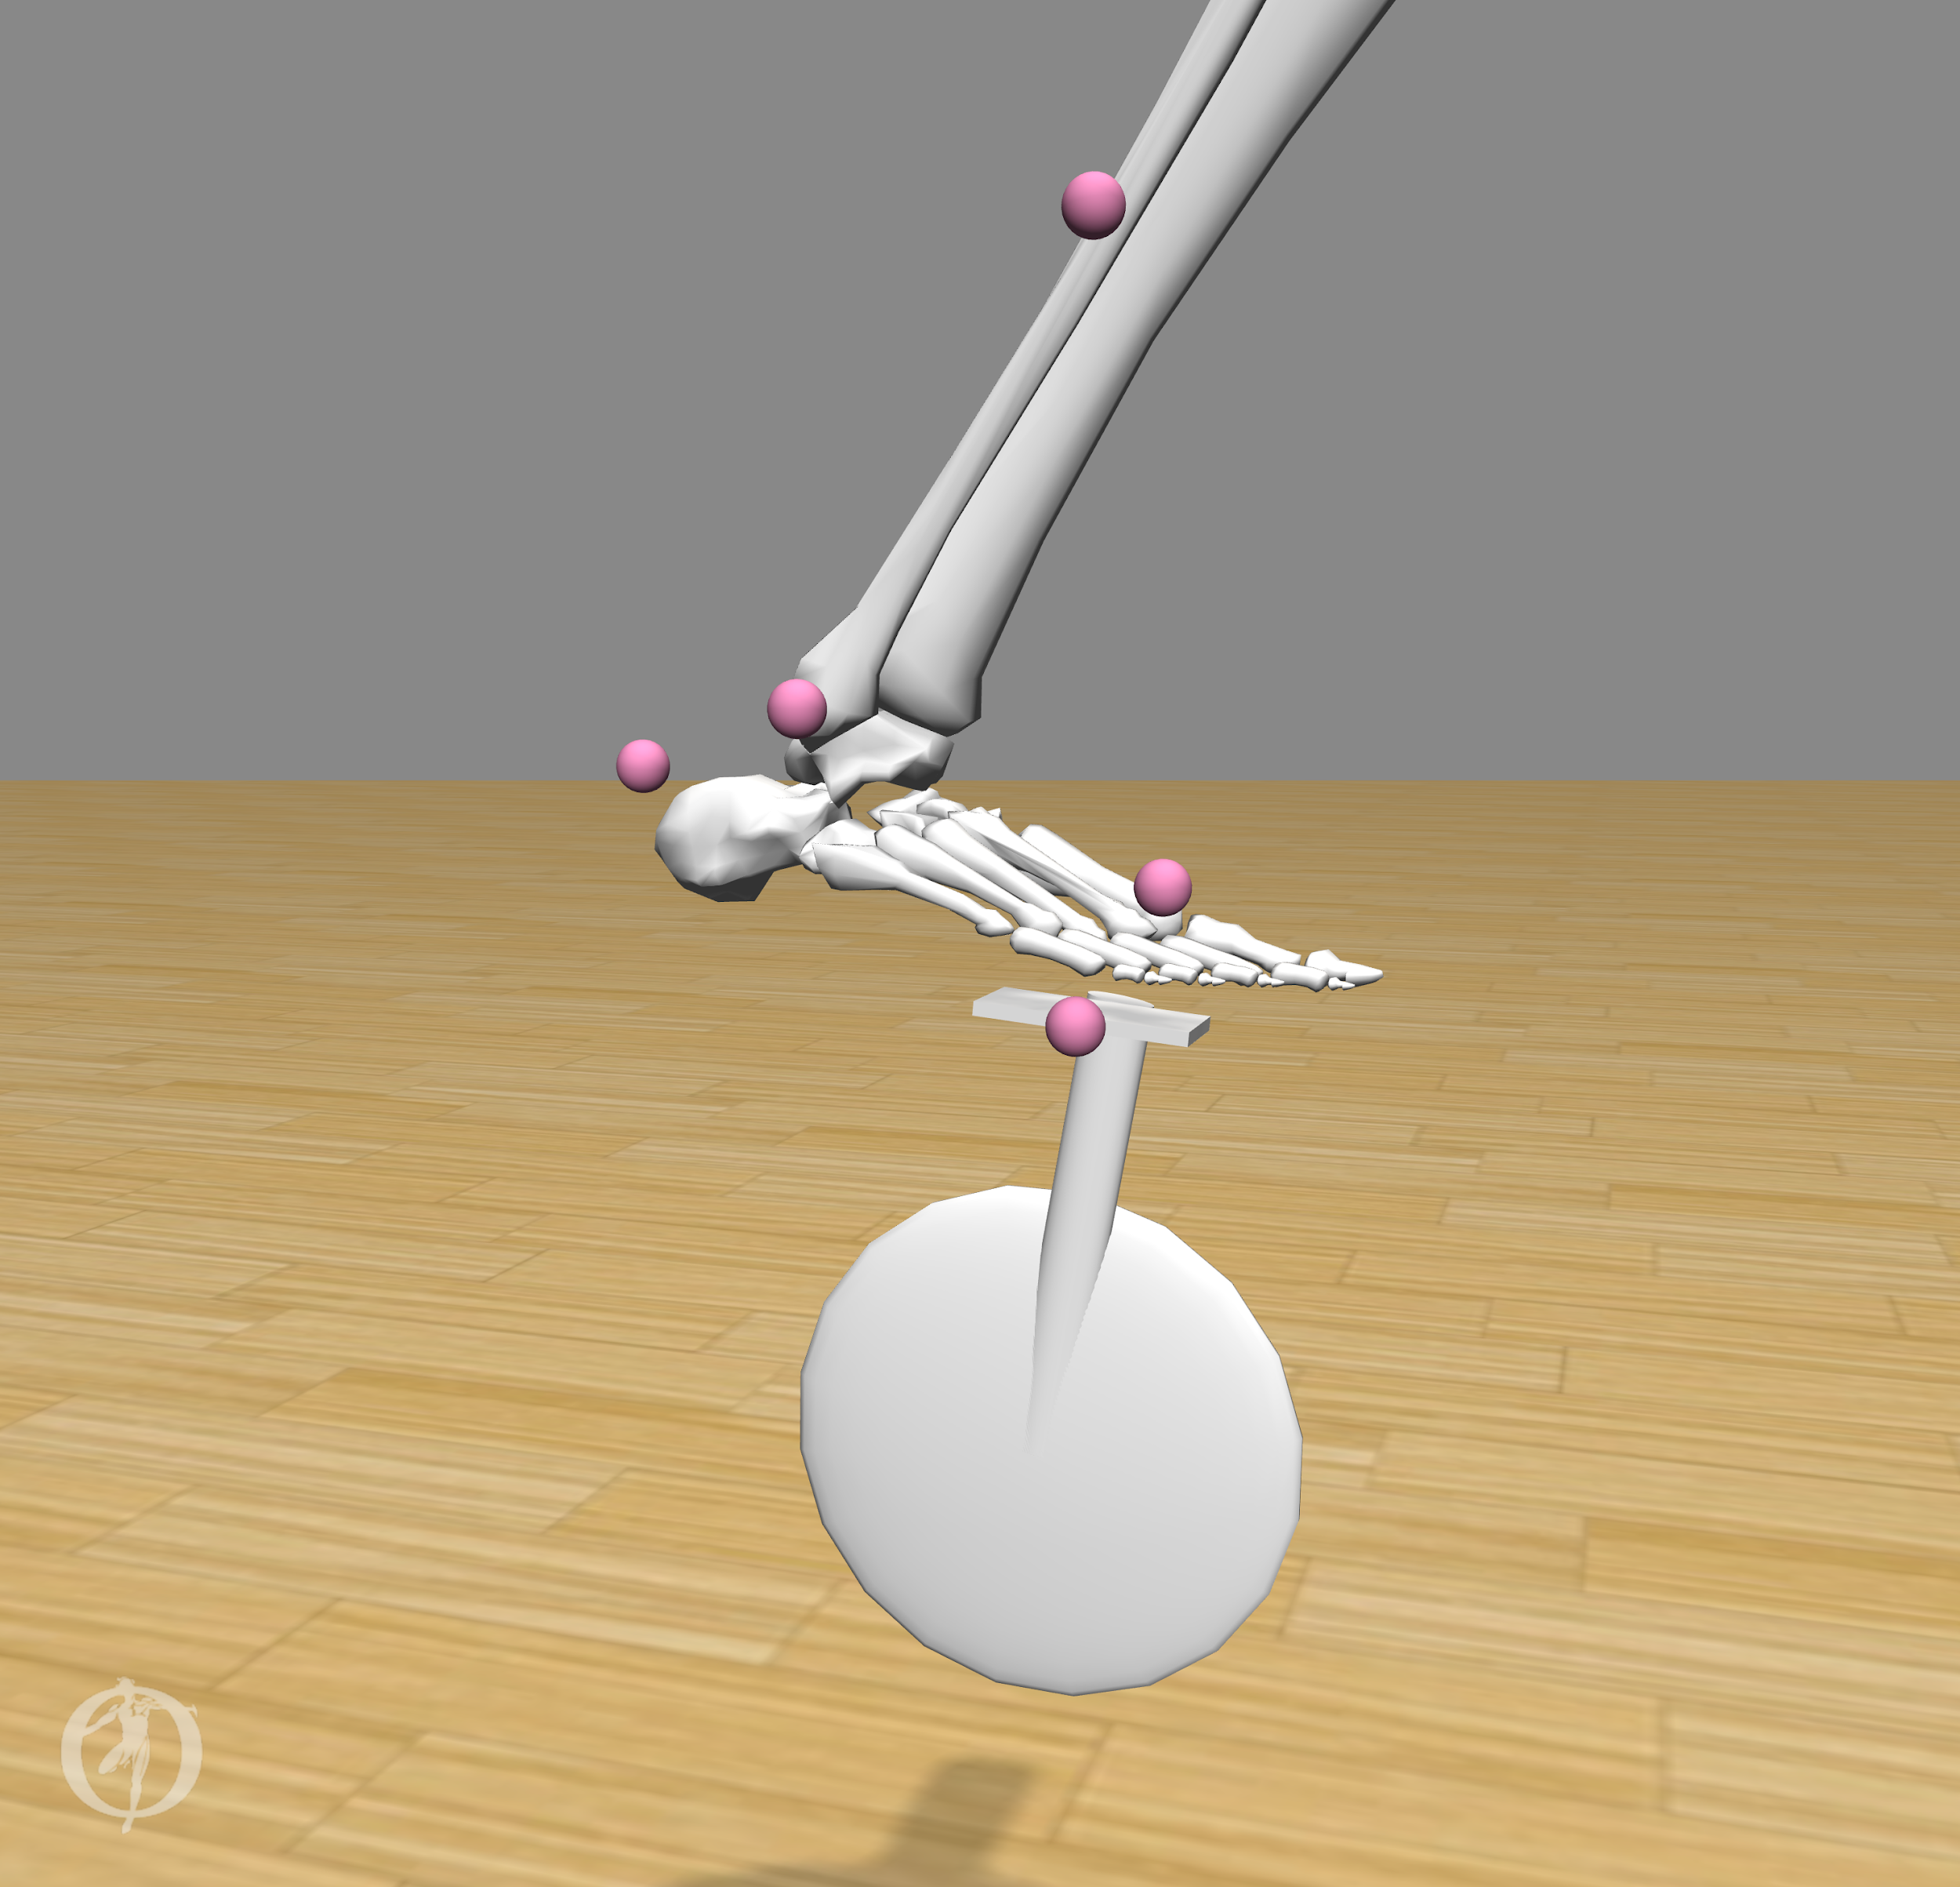
Stanford Course Model Drawbacks
Stanford Course model does not reflect an accurate foot-to-pedal interaction (due to an offset)
The bike pedal angle with respect to the ground is not constrained accurately
The ankle angle is not parameterized anywhere on the model
SR
Notes:
Advice from adrian: we can think about foot pedal gap as a minor issue, and can be like a shoe essentially

Slide 22
Timeline
Week 2 | Week 3 | Week 4 | Week 5 | Week 6 | Week 7 | Week 8 | Week 9 | Week 10
1/22 | 1/29 | 2/5 | 2/12 | 2/19 | 2/26 | 3/5 | 3/12 | 3/19
External forces
Joint angles
Create OpenSim files
Meet with OpenSim Experts
 | Compute muscle forces through CMC
SR

